Slide 1
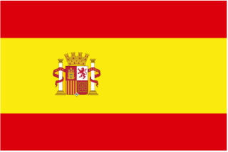
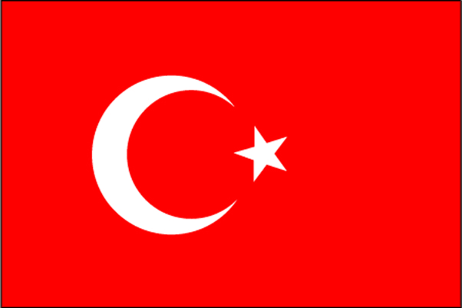
Comenius Project
2012-2014
’’Protection of Biodiversity’’
Germany Italy Spain Turkey Poland

Slide 2
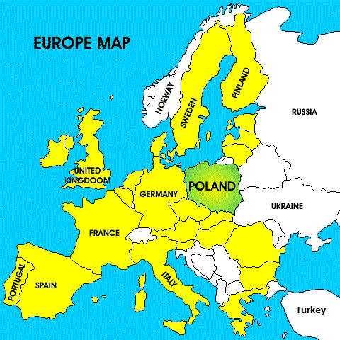
Poland
Poland (Polska), officially the Republic of Poland , is a country in Central Europe, bordered by Germany to the west; the Czech Republic and Slovakia to the south; Ukraine, Belarus to the east; and the Baltic Sea and Kaliningrad Oblast, a Russian exclave, and Lithuania to the north.

Slide 3
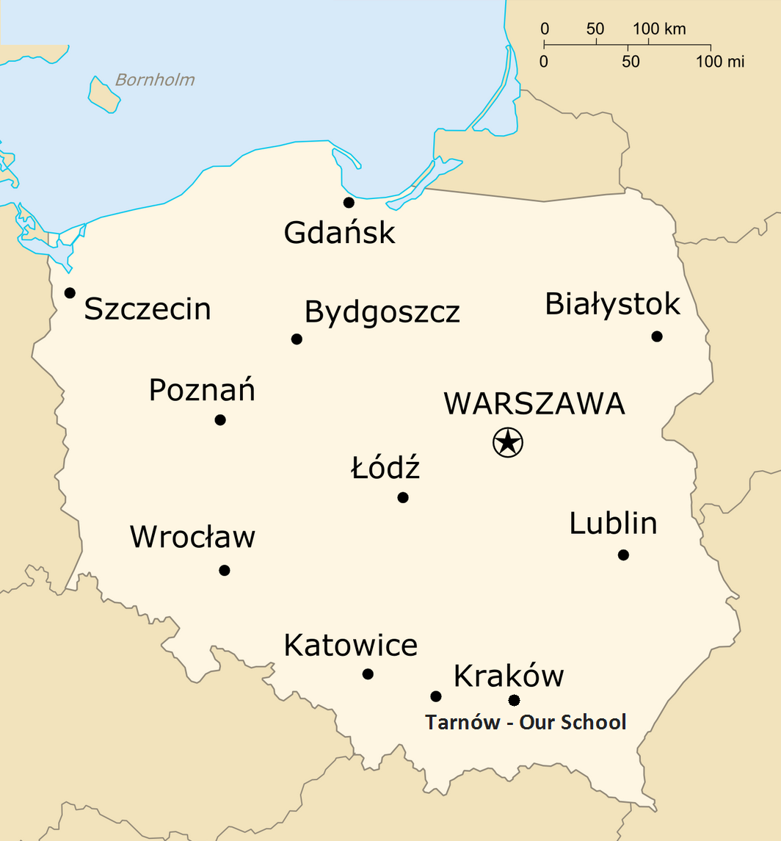
The total area of Poland is 312,679 square kilometres making it the 69th largest country in the world and the 9th largest in Europe. Poland has a population of over 38.5 million people, which makes it the 34th most populous country in the world and the sixth most populous member of the European Union, being its most populous post-communist member.

Slide 4
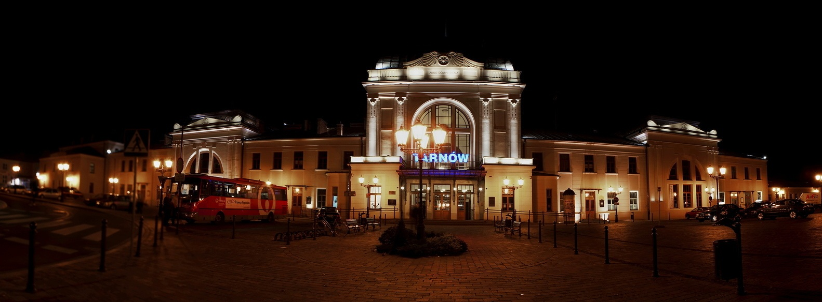
Tarnów
Tarnów is a city in southeastern Poland with over 115,341 inhabitants. Tarnów lies at the Carpathian foothills, on the Dunajec and the Biała rivers. The area of the city is 72,4 km², and it is divided into 16 districts. A few kilometers west of the city lies the district of Moscice, built in the late 1920s, together with a large chemical plant. The district was named after President of Poland, Ignacy Mościcki.

Slide 5
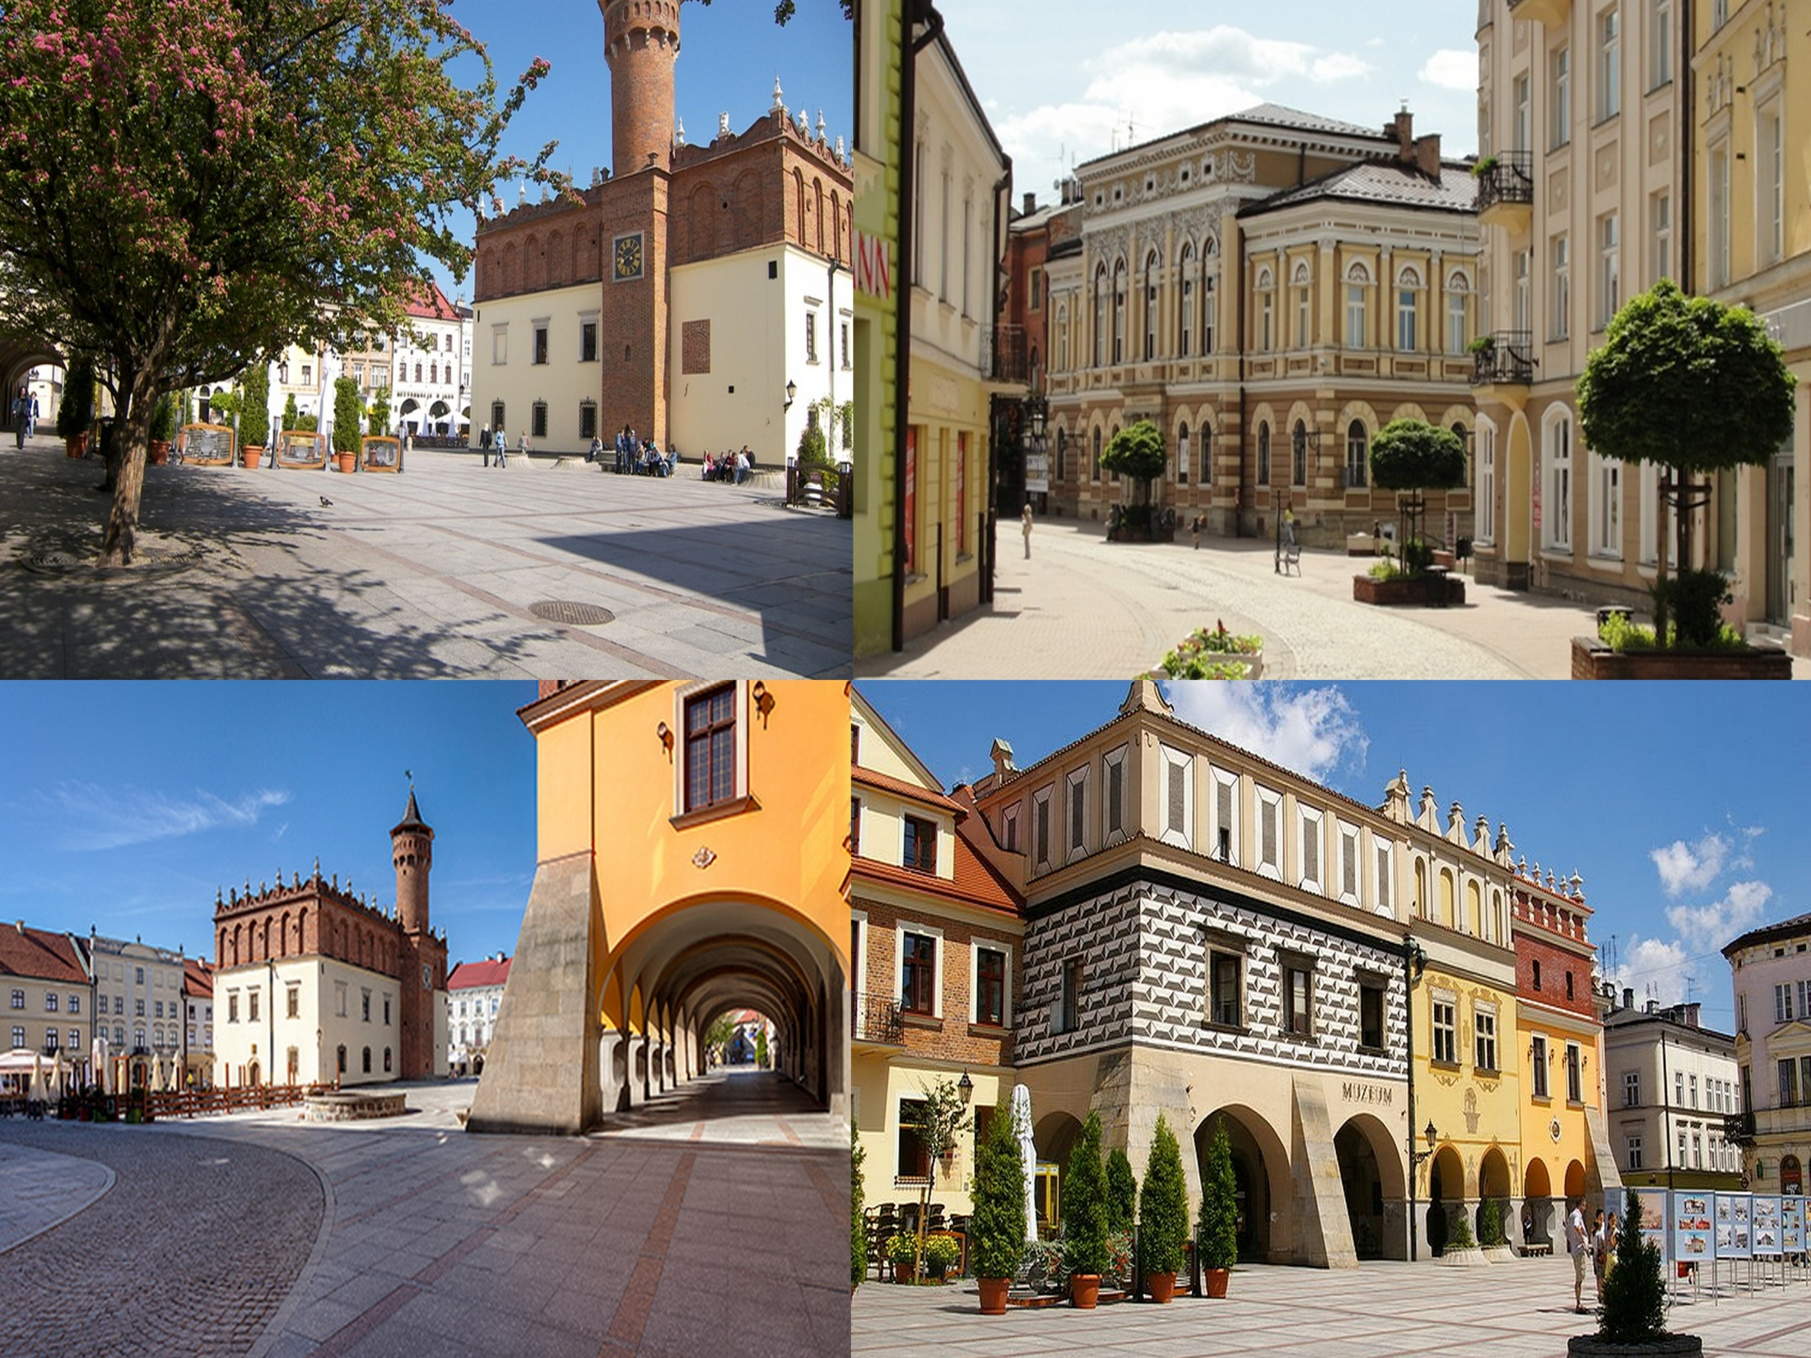

Slide 6
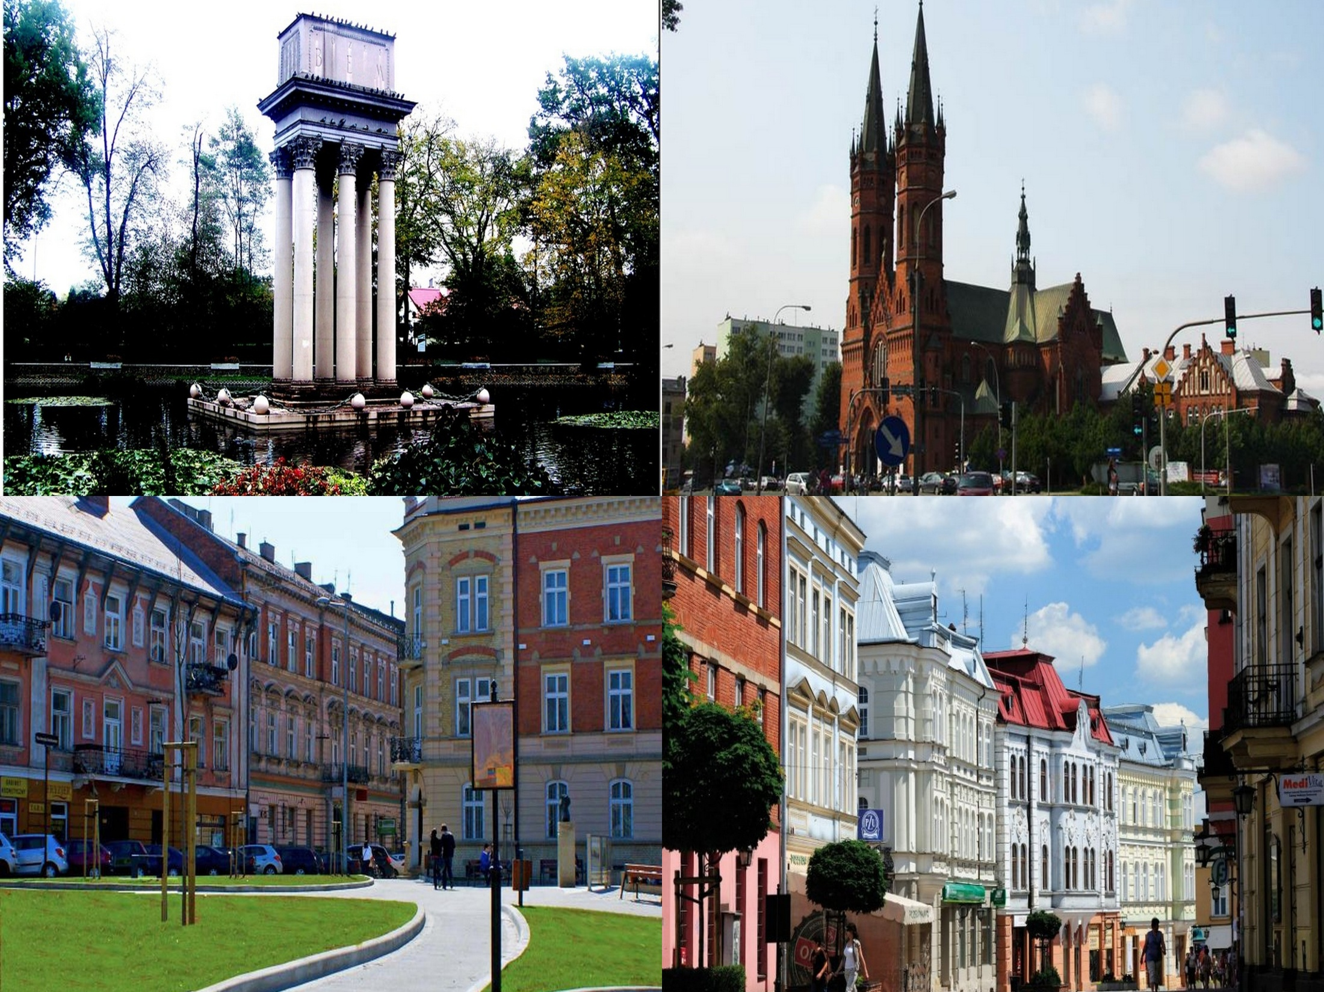

Slide 7
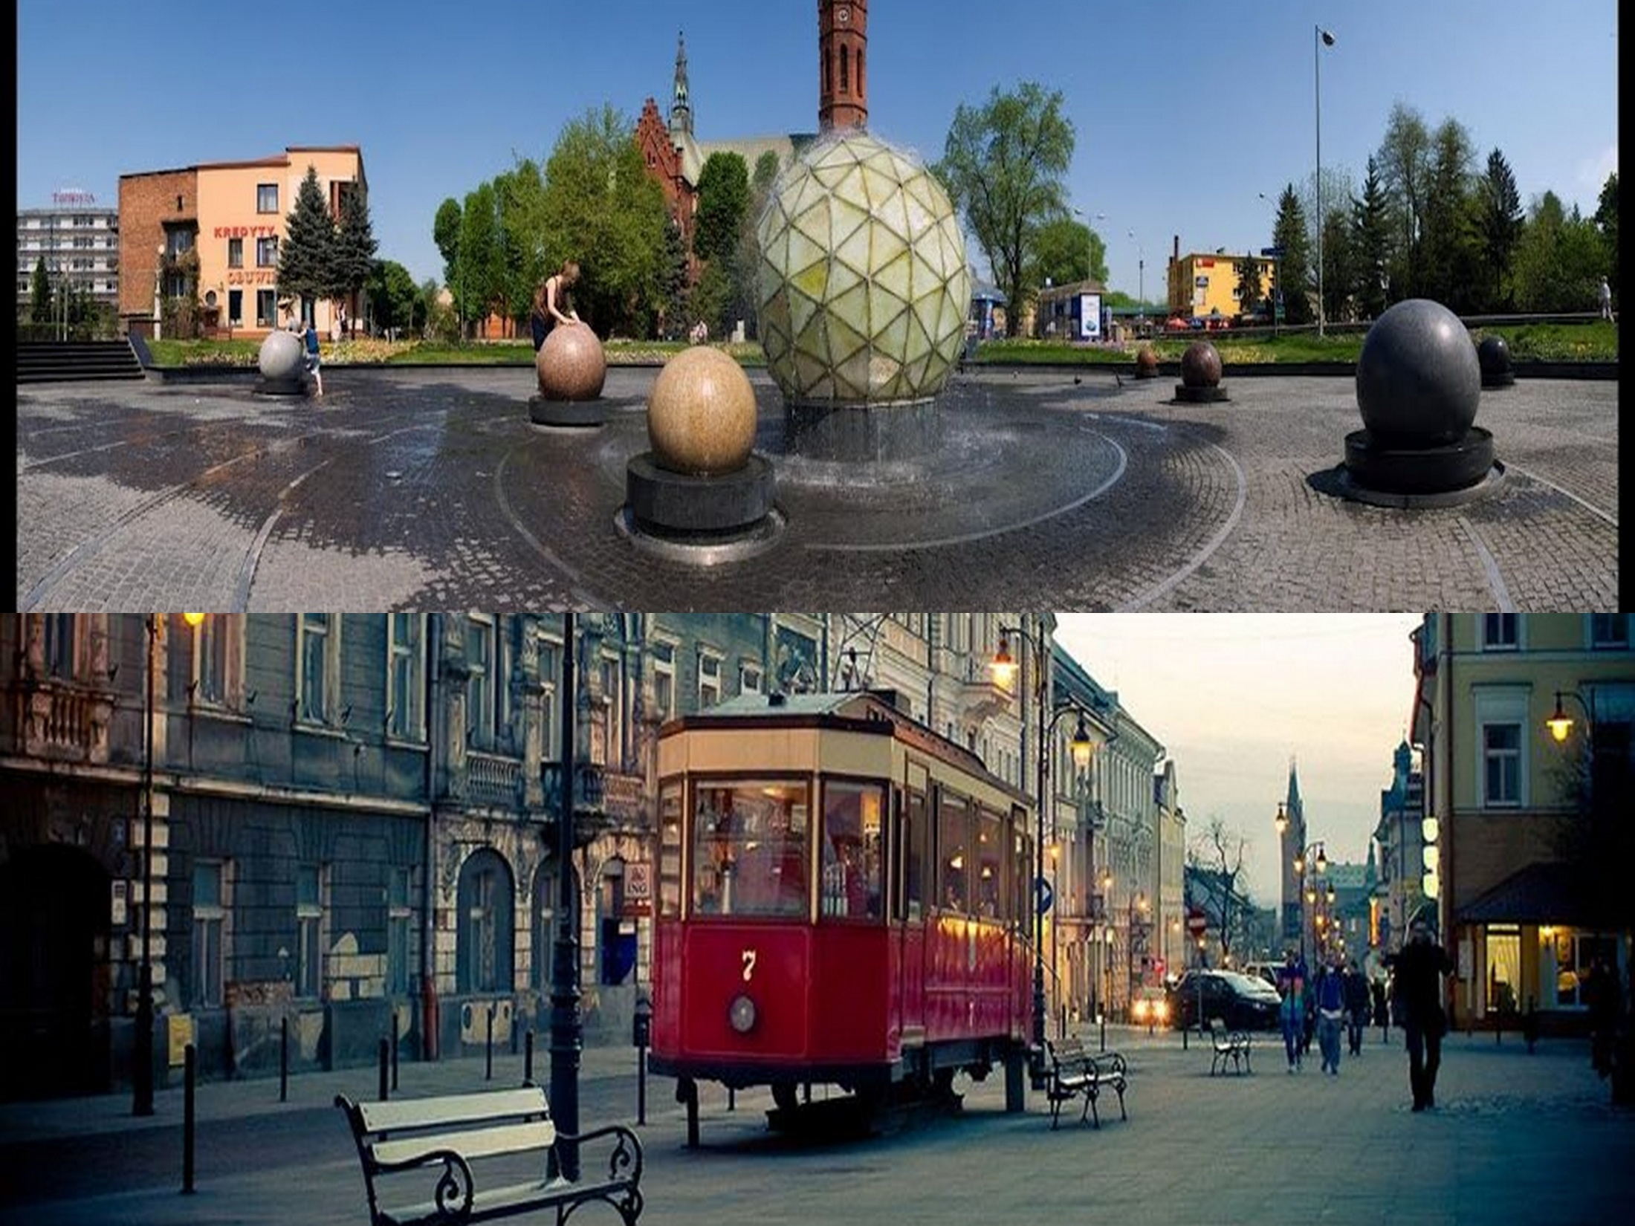

Slide 8
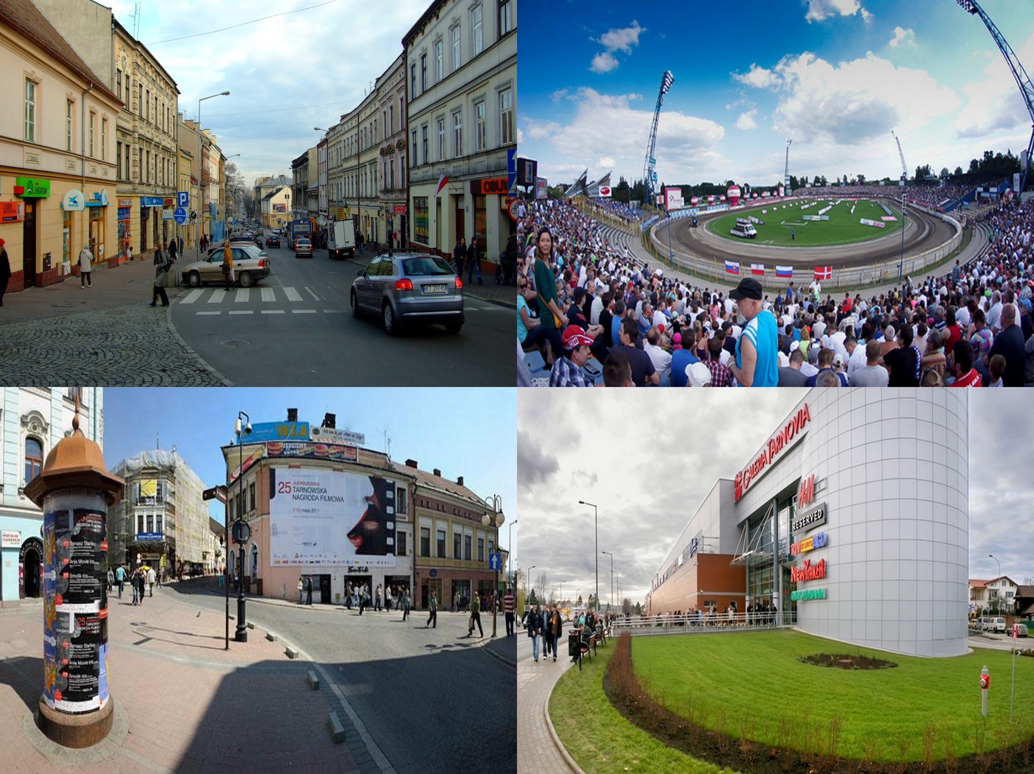

Slide 9
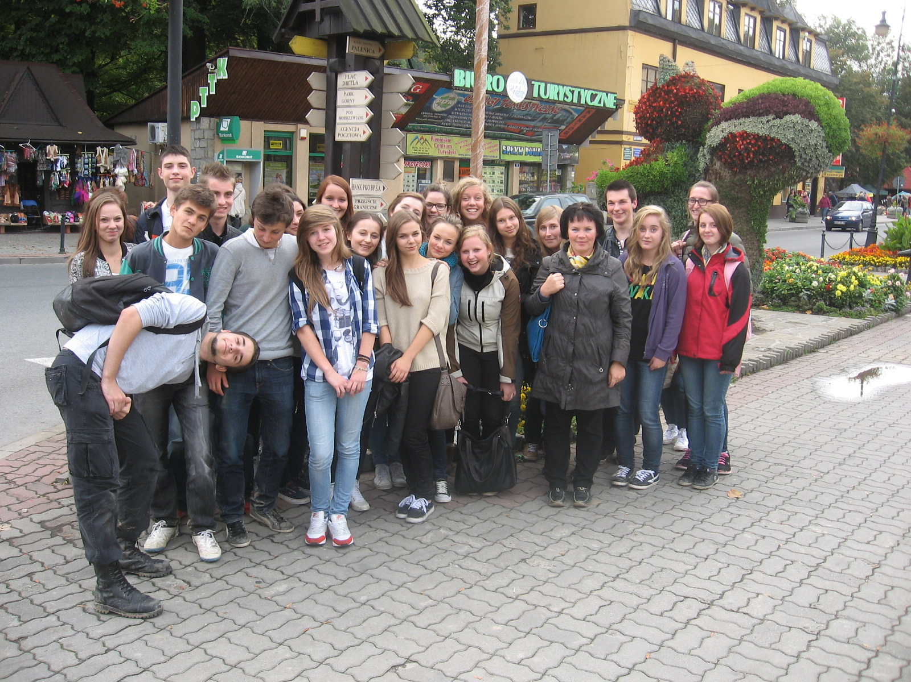

Slide 10
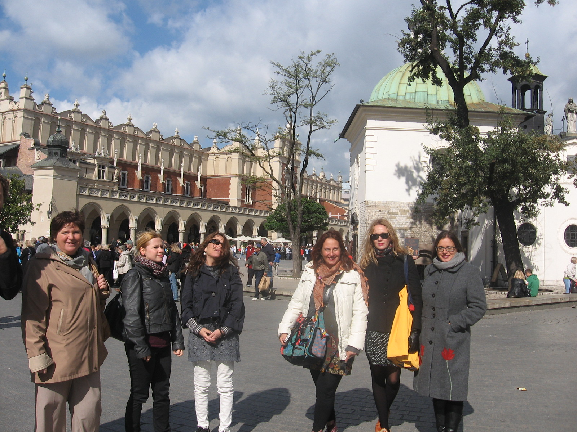

Slide 11
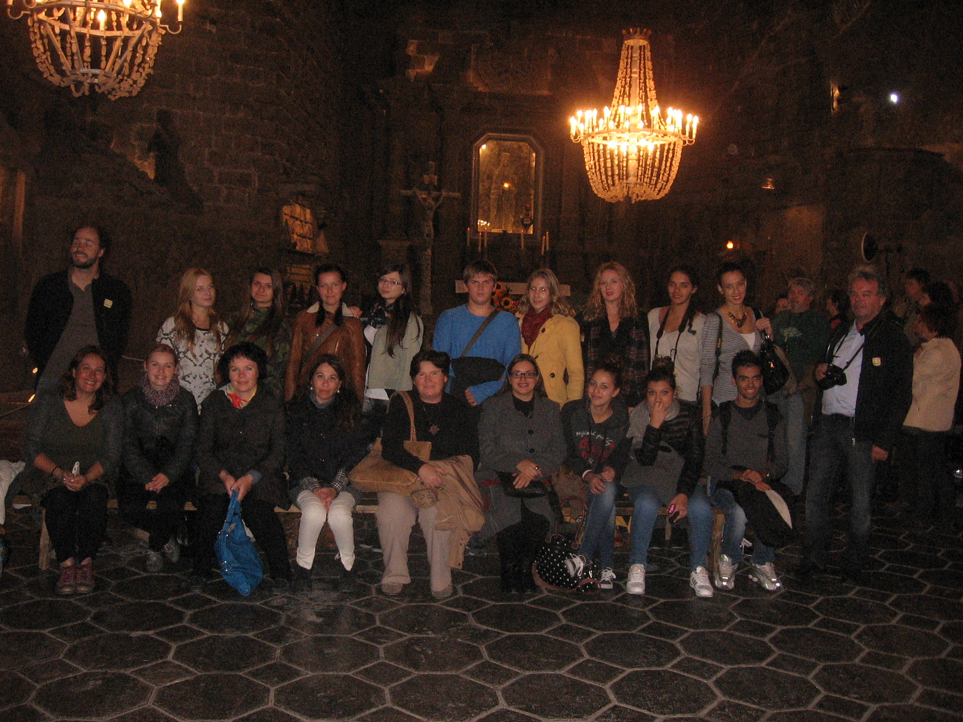

Slide 12
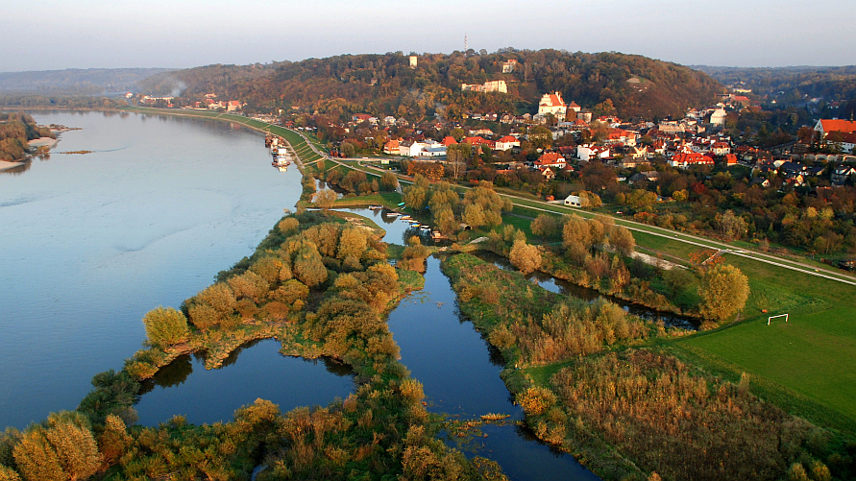
Biodiversity of Poland
Poland is a country with a huge natural diversity. Its biodiversity is among the richest in Europe. The decisive factor in this is the transitional climate which is influenced by oceanic and continental air masses, a favourable geographical position in the centre of the continent with no natural barriers to the east or the west, a varied geological structure, varied landform features and hydrographic make-up and varied soil types.

Slide 13
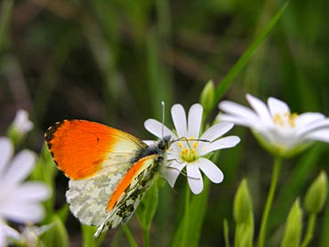
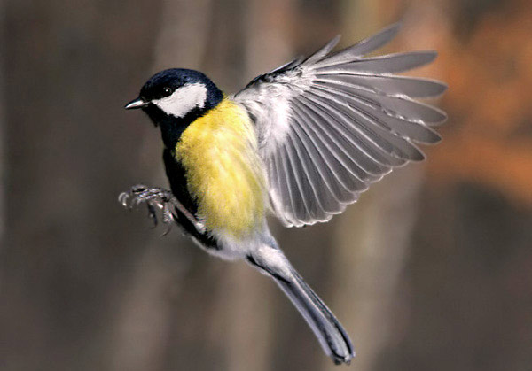
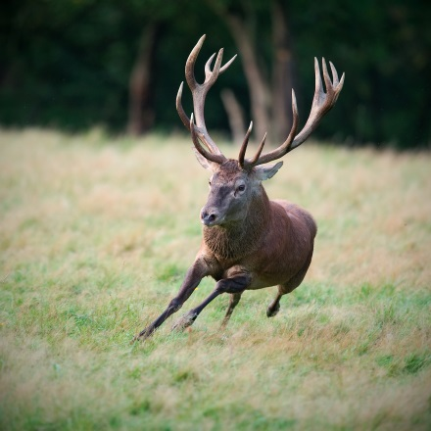
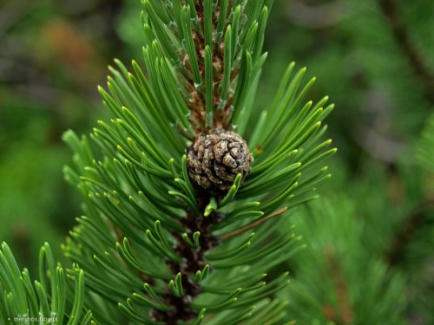
Biodivesity of Tarnów
In Małopolska, Tarnów we can meet endangered spieces of wild and farmed plants and animals that in the near future will disappear from the Earth and human memory. In some places you can still find the old species, varieties, ecotypes or landraces of crops, which in the highest degree should be protected from destruction.

Slide 14
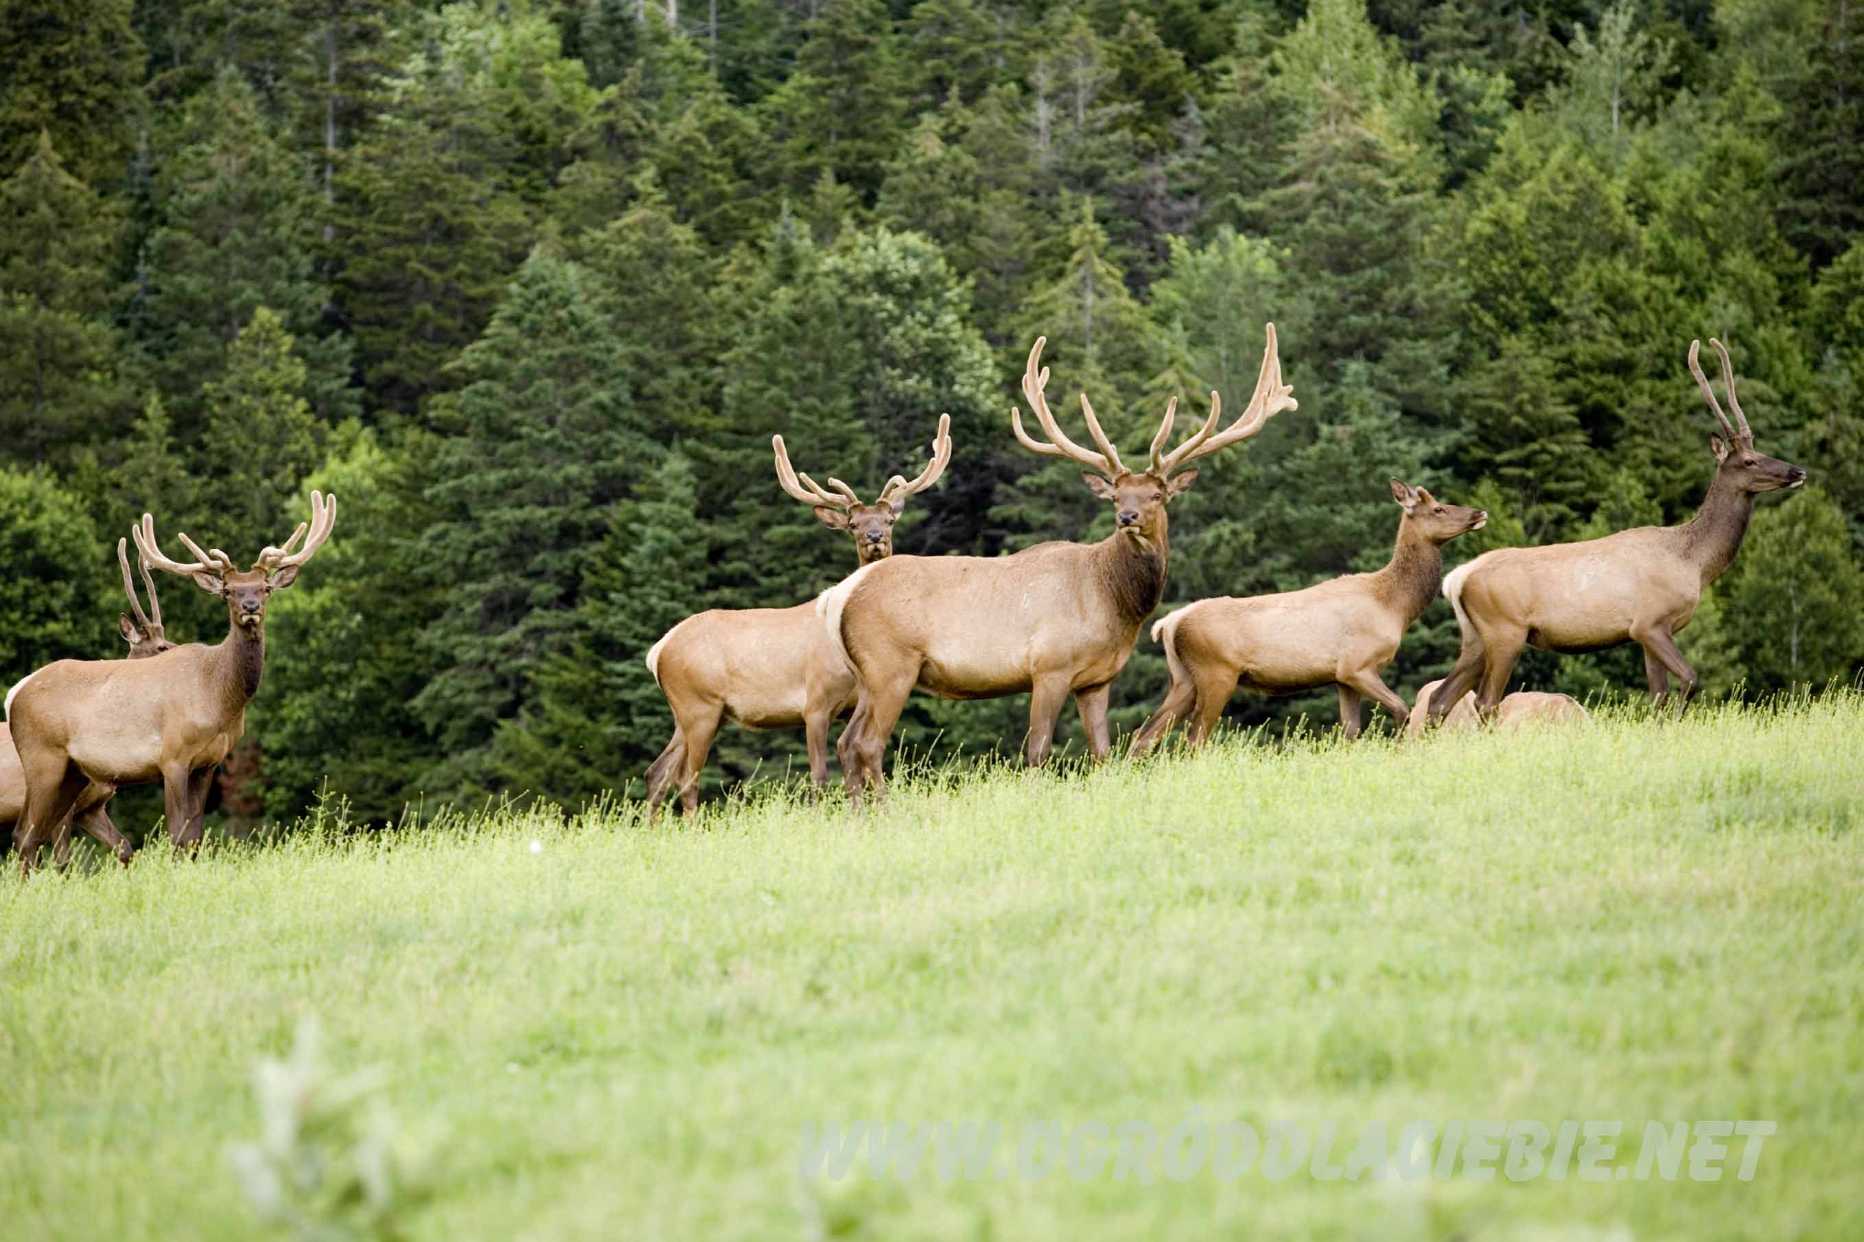
The most typical species for the Poland live in the forest because the development was linked to the fauna and flora. One of the most interesting and characteristic animals are …

Slide 16
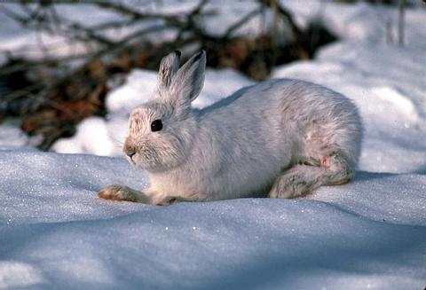
Hares are similar to rabbits but there are a number of differences but people often can’t see them.
Hares are usually larger than rabbits and have longer ears. Whats more rabbits give birth to their young in burrows while hares give birth in more open areas.
Hares are born with fur and their eyes open.
Hares aren’t kept as house pets unlike rabbits
Hares usually live by themselves or in pairs.
Young hares are called leverets.
Like rabbits, hares are herbivores (plant eaters).
A group of hares is known as a ‘drove’.
It can be shocking but hares can run at speeds up to 72 km/h !!

Slide 17
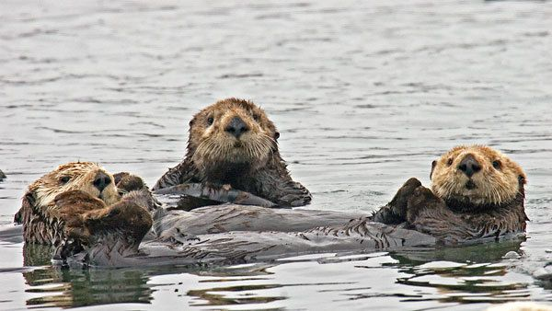
Beavers
The beaver is the second largest rodent in the world. Beavers are known for building dams, canals, and lodges (homes) and for their wide, flat tail, used for slapping the surface of the water to warn other beavers of approaching danger. They are semi-aquatic animals that spend most of their time in rivers and streams.

Slide 18
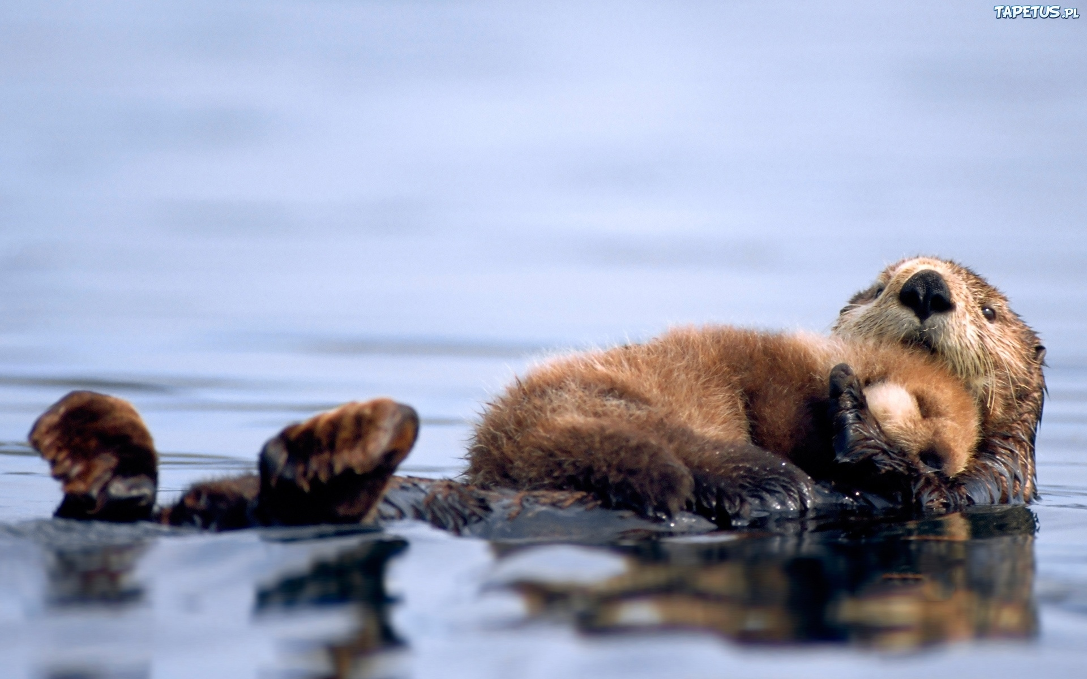
Beavers are second only to humans in their ability to manipulate and change their environment. In contrast to people, beavers do it without polluting the environment. That is one of the reasons why we find the flat-tailed species fascinating.

Slide 19
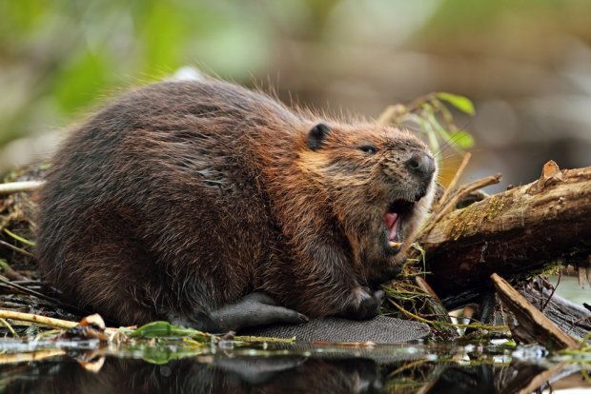
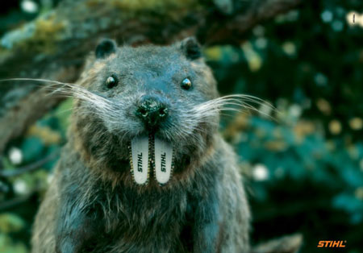
Do you know that..
Beavers have poor eyesight, but are equipped with strong senses of hearing, smell and touch. Beavers have sharp teeth which continue to grow throughout their lifetimes. Beavers can stay underwater for up to 15 minutes. Beavers move slowly on land but are good swimmers and can swim up to 5 mph. Female beavers are larger than male beavers of the same age.
Beavers are monogamous. Beavers are nocturnal creatures and work at night.

Slide 20
-Beavers have poor eyesight, but are equipped with strong senses of hearing, smell and touch -Beavers have sharp teeth which continue to grow throughout their lifetimes. -Beavers can stay underwater for up to 15 minutes. -Beavers move slowly on land but are good swimmers and can swim up to 5 mph. -Female beavers are larger than male beavers of the same age. -Beavers are monogamous -Beavers are nocturnal creatures and work at night. -Beavers are second only to humans, in their extraordinary ability to influence and change their environment. .

Slide 21
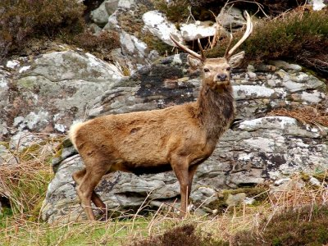
Deer
The whitetail deer is one of the best known and easily recognized large mammals and can be found around the world. You can see them walking through town, grazing in the fields or rotting on the side of the road. There are about 100 types of deer (30 recognized), all of which have many characteristics in common and in Poland there are about 28 types of deer.

Slide 22
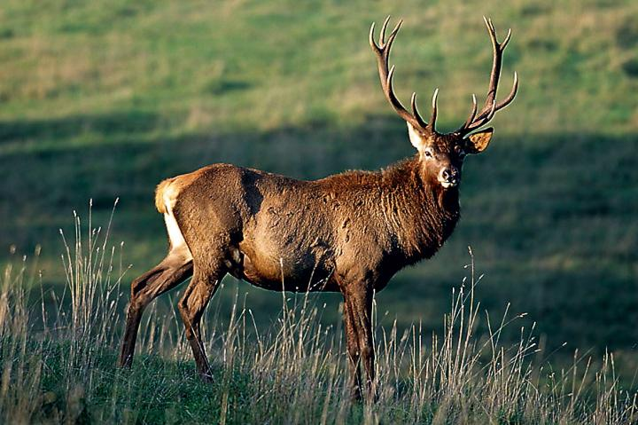
Deer
The whitetail deer is one of the best known and easily recognized large mammals and can be found around the world.
You can see them walking through town, grazing in the fields or rotting on the side of the road. There are about 100 types of deer (30 recognized), all of which have many characteristics in common and in Poland there are about 28 types of deer.

Slide 23
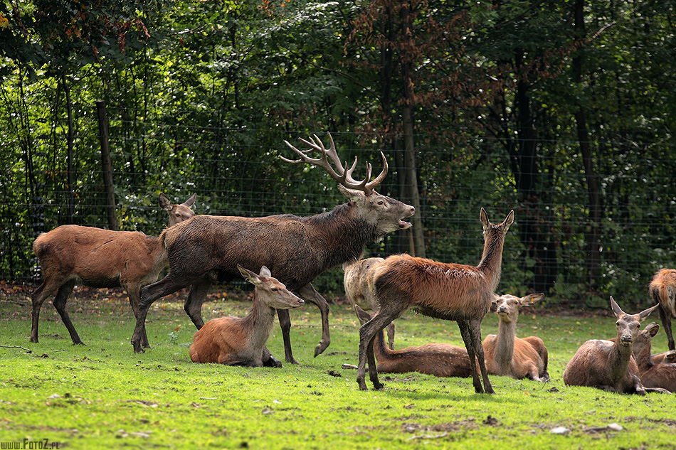
Facts
Male deer may be called buck, bulls, stags, or harts.
Female deer may be called does, cows, or hinds.
Young deer are know as fawns or calfs . Deer are ruminants, also know as cud chewers
Top running speed of a whitetail (40 mph)
Top swimming speed of a whitetail (13 mph)
Average tail length of a whitetail (10.6 inches)
Average number of pounds of vegetation a whitetail will consume in a single day (7)

Slide 24
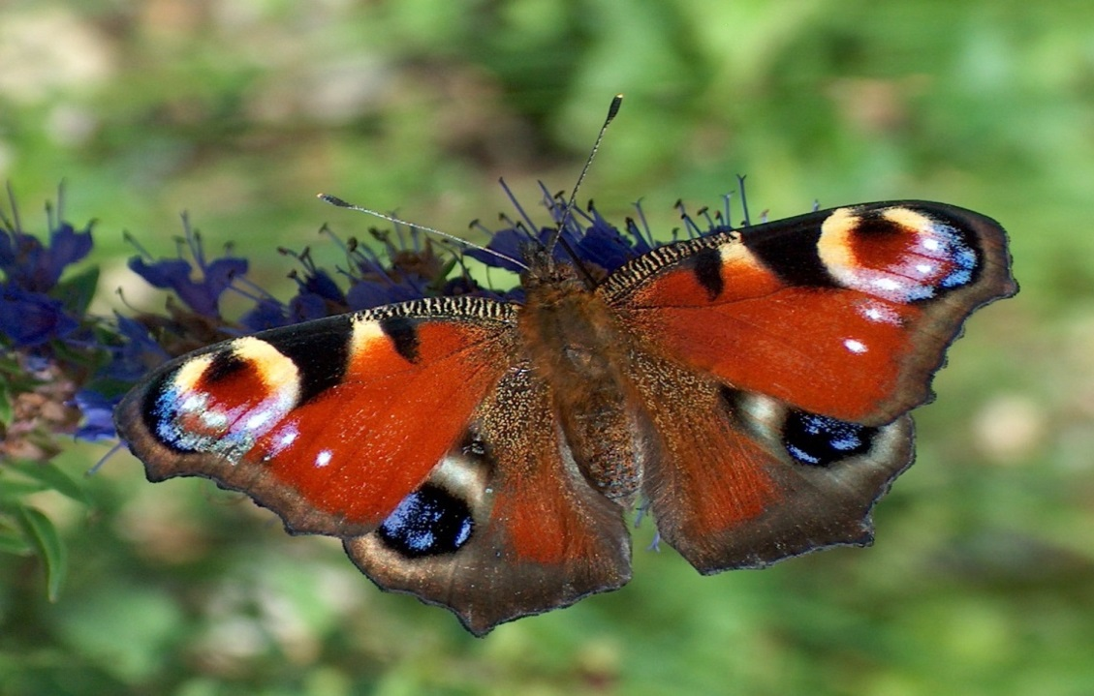
Butterflies
Butterflies belong to the order lepidoptera. There exist approximately 160,000 different species of butterflies in the world! In Poland we have almost 30,000 spiecies !! Some of them are endangered in our region.

Slide 25
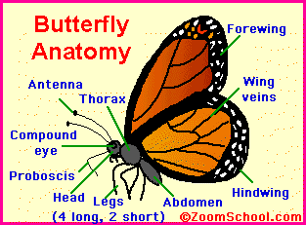
Butterflies are beautiful, flying insects with large scaly wings. Like all insects, they have six jointed legs, 3 body parts, a pair of antennae, compound eyes, and an exoskeleton. The three body parts are the head, thorax (the chest), and abdomen (the tail end).
The butterfly's body is covered by tiny sensory hairs. The four wings and the six legs of the butterfly are attached to the thorax. The thorax contains the muscles that make the legs and wings move.

Slide 26
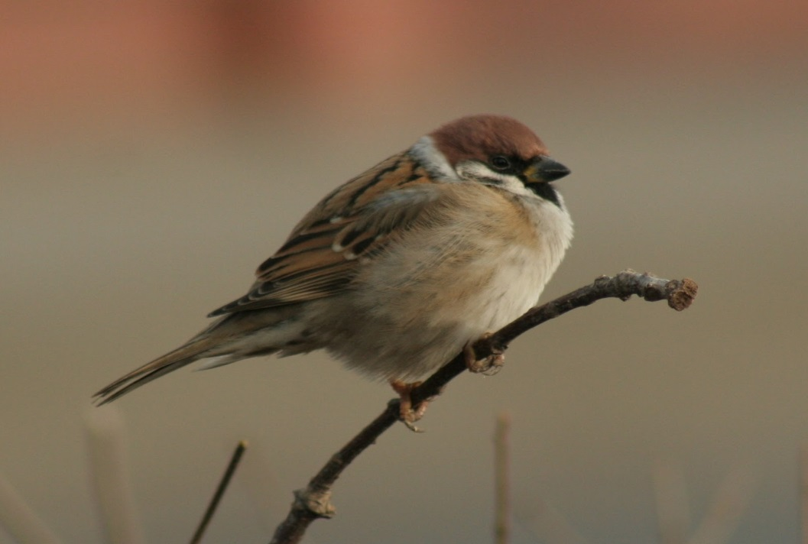
Sparrows and Titmouse
Typical birds for our region are sparrows and titmouse. Everybody who lives in Tarnów and near to Tarnów knows those spieces.

Slide 27
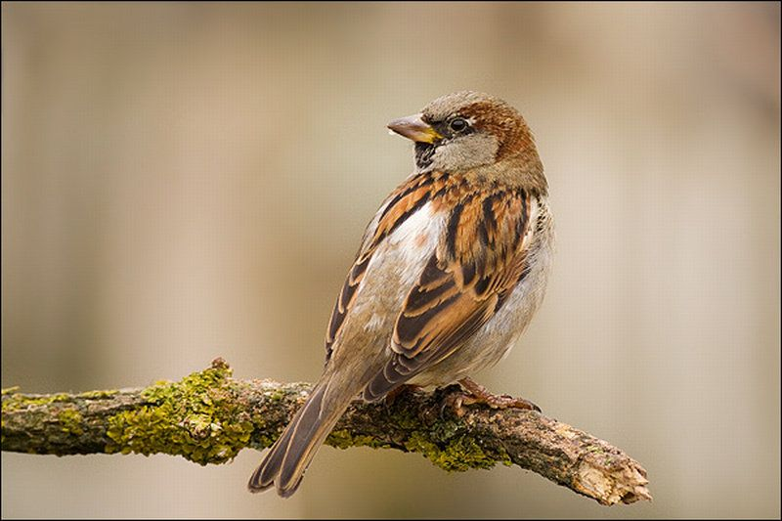
Sparrows
Sparrows are small, chubby brown-grey birds with short tails and short & blunt yet powerful beaks. They eat seeds but can also eat insects.

Slide 28
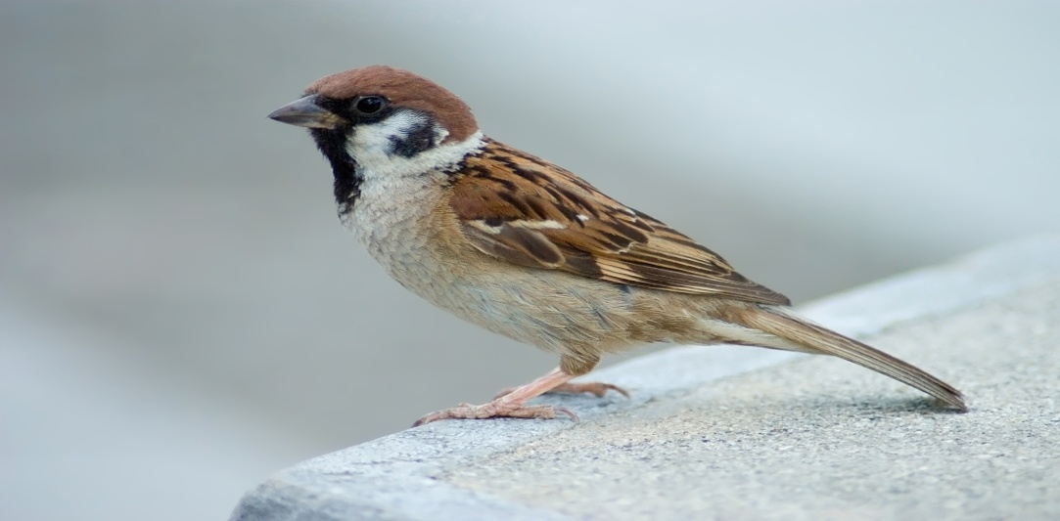
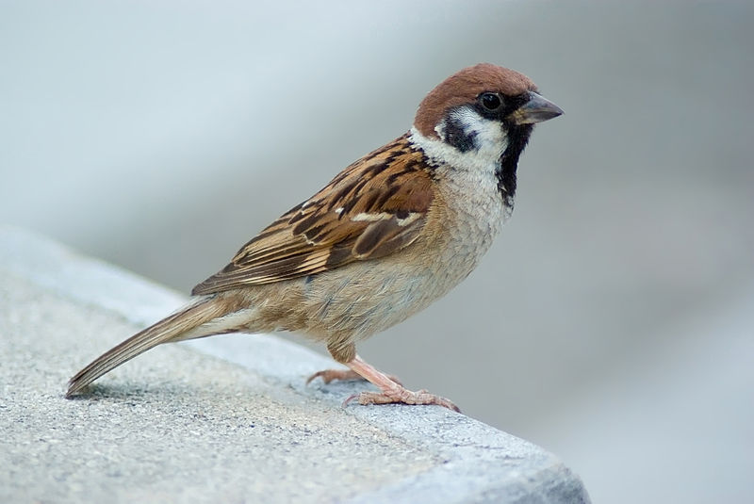
Facts About Sparrows
Sparrows are social birds, nesting closely to one another and flying and feeding in small flocks. They live in nests, nests are located under roofs, bridges, in three hollows etc. Sparrows can swim to escape from predators, although are not a water bird. Male sparrow has reddish back and black bib, female sparrow has brown back with eyestripe.
Their diet consists of seeds, small invertebrates, crumbs etc

Slide 29
Titmouse
These birds have grey upperparts and white underparts with a white face, a grey crest, a dark forehead and a short stout bill; they have rust-coloured flanks. They make a variety of different sounds, most having a similar tone quality.

Slide 30
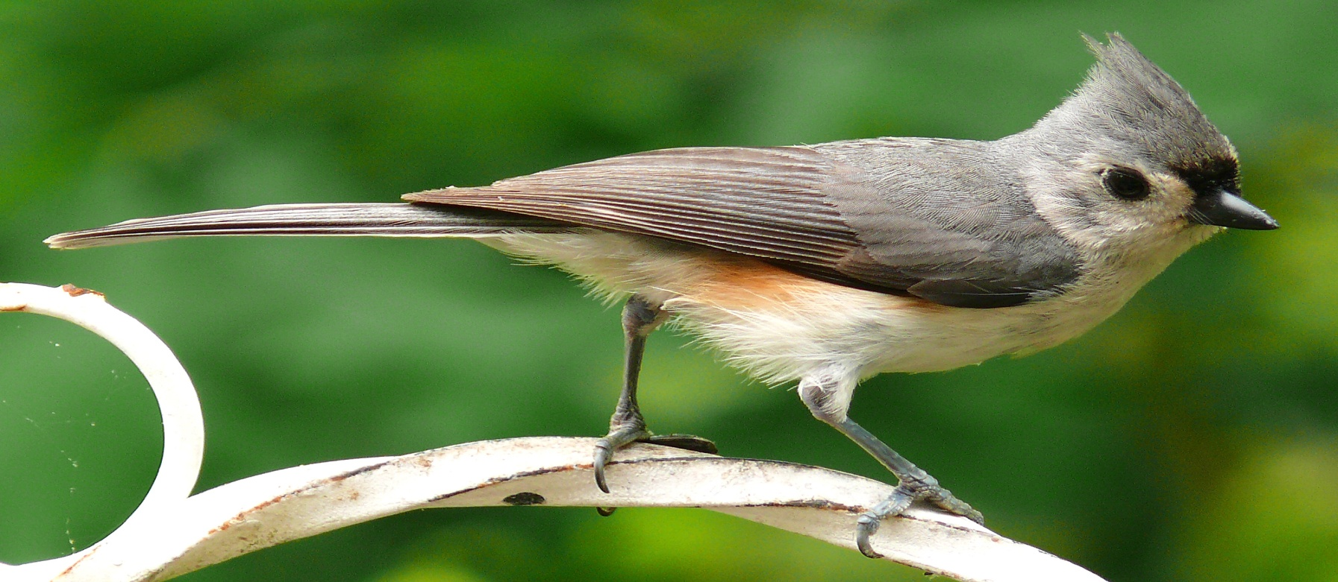
They forage actively on branches, sometimes on the ground, mainly eating insects, especially caterpillars, but also seeds, nuts and berries. They will store food for later use. They tend to be curious about their human neighbors and can sometimes be spotted on window ledges peering into the windows to watch what's going on inside. They are more shy when seen at bird feeders; their normal pattern there is to scout the feeder from the cover of trees or bushes, fly to the feeder, take a seed, and fly back to cover to eat it.

Slide 31
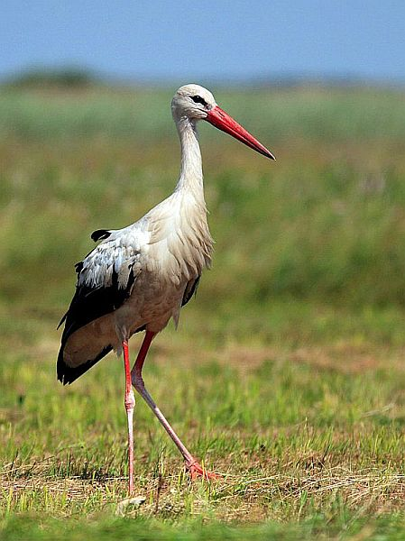
Storks
Storks are large, long-legged, long-necked wading birds with long, stout bills. Many species are migratory. Most storks eat frogs, fish, insects, earthworms, small birds and small mammals. There are 19 living species of storks in six genera.

Slide 32
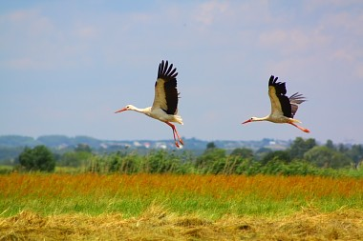
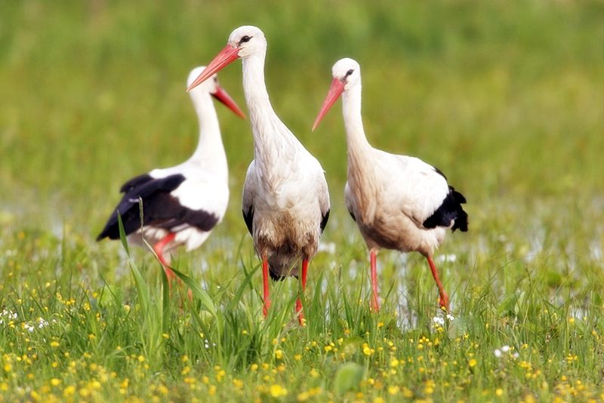
Storks, being constantly present in the Polish landscape, remain its vivid symbol and have found their place in our folktales, proverbial sayings, superstitions thus entering Polish culture as its inseparable symbol.

Slide 33
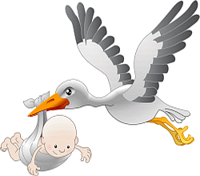
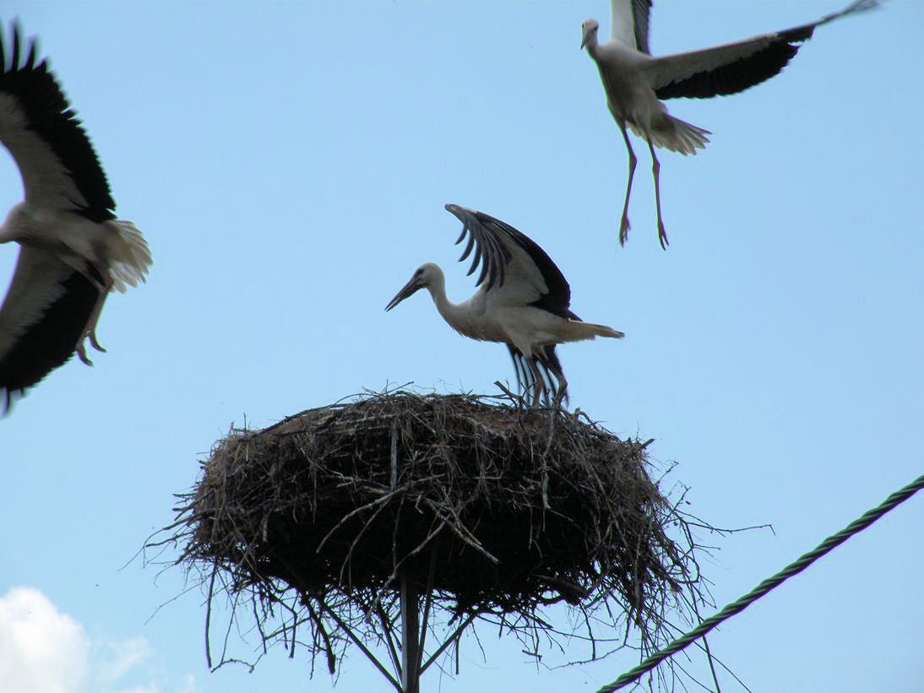
In Poland storks are also known for saying that they bring children.

Slide 34
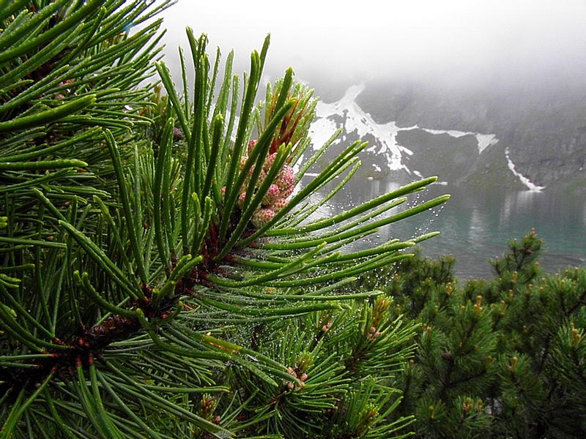
Mugo Pine Pinus mugo
Mountain Pine is protected because it was destroyed, burned and cut in mass in the past.

Slide 35
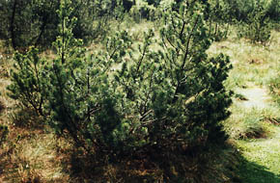
Mugo pines grow in European mountains, such as the Pyrenees, Alps, Erzgebirge, Carpathians, northern Apennines, and Balkan Peninsula ranges but the largest amount of them we can meet in our region, Małopolska, because it is situated in the mountains.

Slide 36
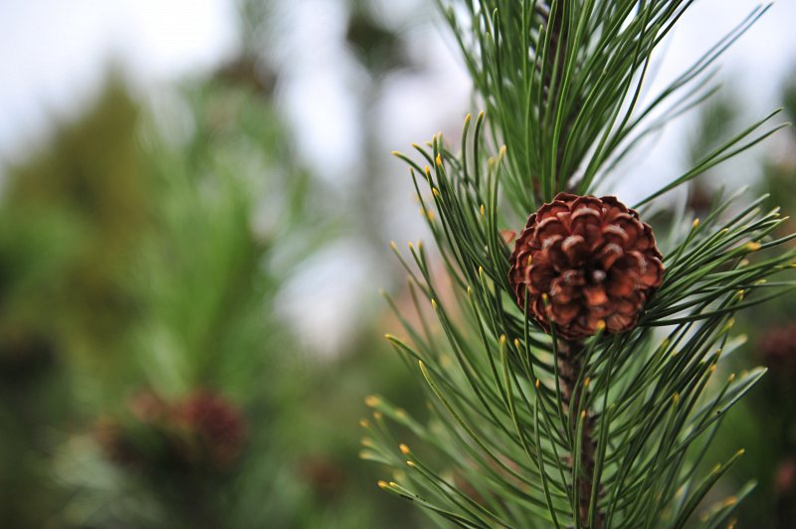
Fruit:
The female flowers of the pine tree are called cones.
Both female and male cones appear on a tree.
Cones are brown, dry and hard, oval, 1 to 3 inches long. They do not attract wildlife.

Slide 37
The birch tree
These midsized trees grow from 30 to 65 feet tall. Birch trees generally grow thin and tall, looking like a graceful balerina.
They achieve maturity at about fifty years of age, but can live up to about one hundred years.

Slide 38
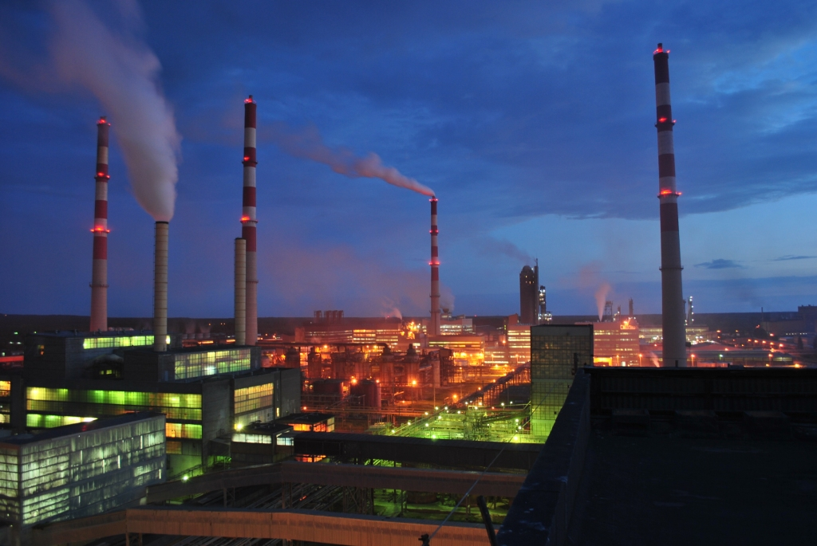
Pollution
In the past 50 years, Poland has experienced deterioration of the environment and loss of biodiversity. Emissions of toxic gases, such as SO₂, have reached 3 to 4 million tons annually, widely affecting flora, fauna, and human health. Almost all surface waters are heavily polluted. More than 75% of the water in the Vistula, Poland's largest river, is unsuitable even for industrial use.

Slide 39
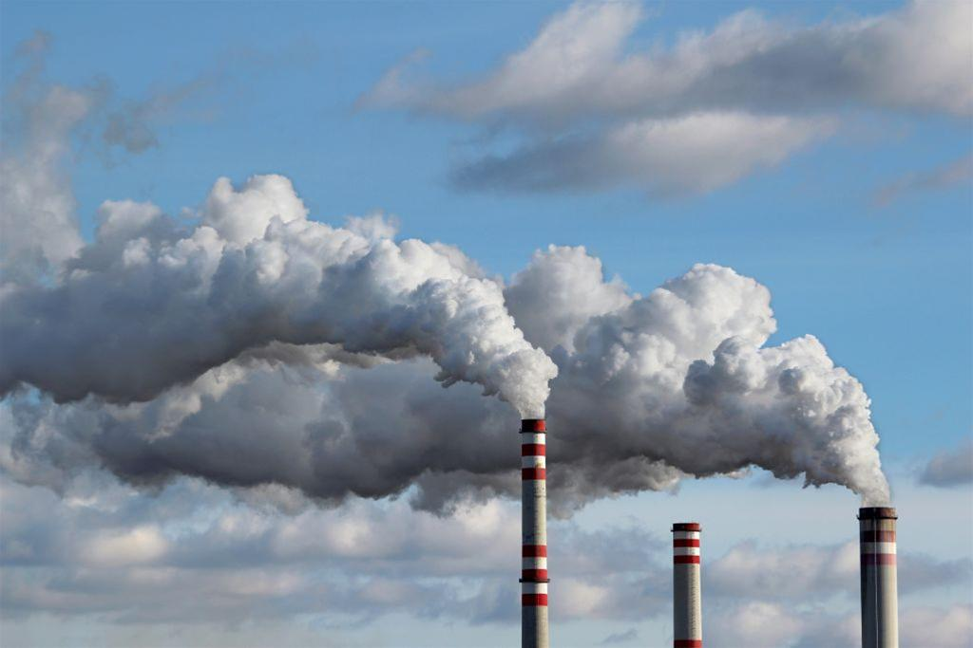
Environmental pollution, habitat loss and fragmentation, and industrialization of agricultural lands and forests have contributed to the loss of biodiversity. As many as 2500 plant species may be endangered (≈25% of all species) and approximately 228 (≈2%) have been extirpated from Poland. The largest losses of flora and fauna have occurred in wetland ecosystems.

Slide 40
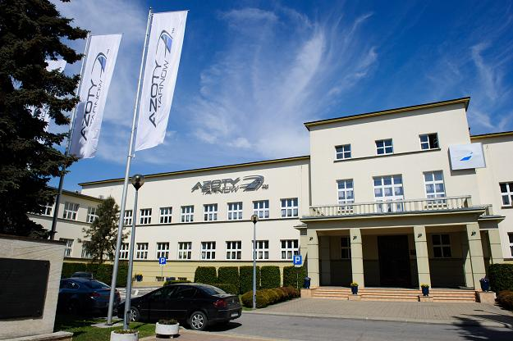
The reason for this pollution can be chemical company which is situated in our city, Tarnów, which is called Azoty Tauron.

Slide 41
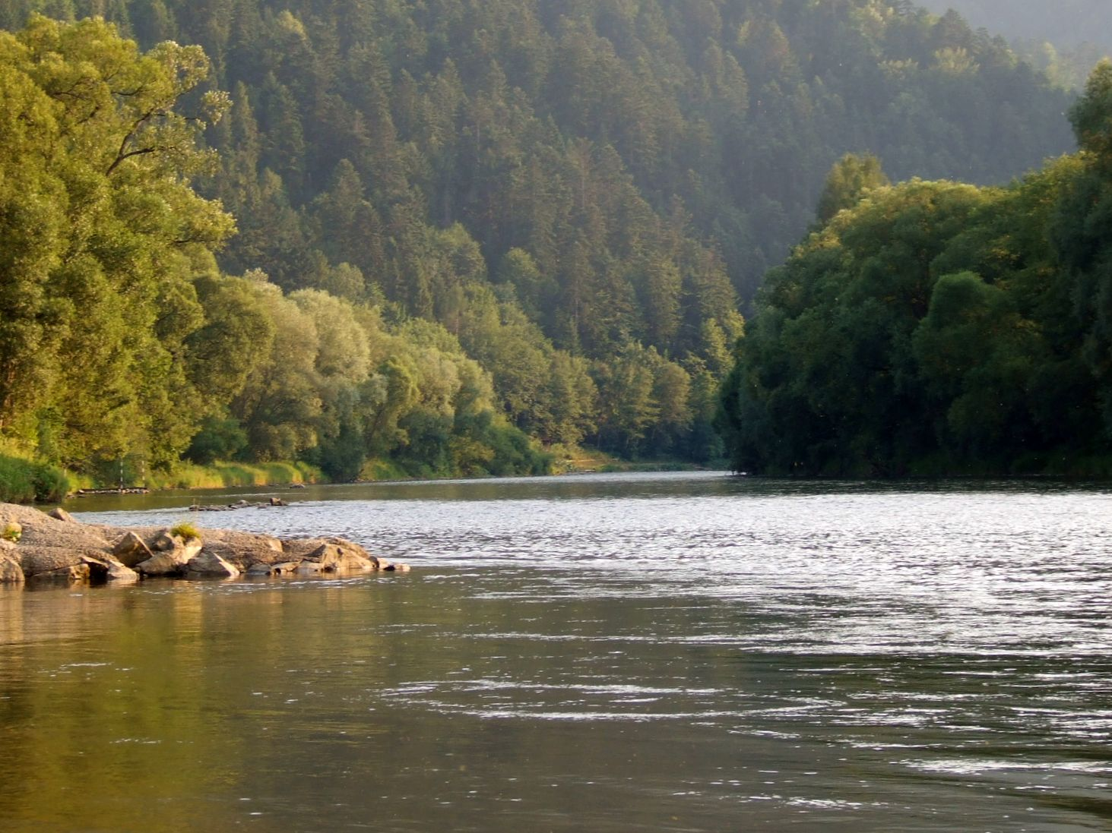
Rivers are sources of water, food and energy. They are also one of the few places on the continent where important ecosystems were valuable. Unfortunately, very often rivers become a landfill of toxic chemicals produced by industrial plants and cities.
In the 90’s of the XXI century The Dunajec River was very polutted because of toxic chemicals produced by Azoty Plant. However, due to tourist interest in this river, special organizations deal with this problem.

Slide 42
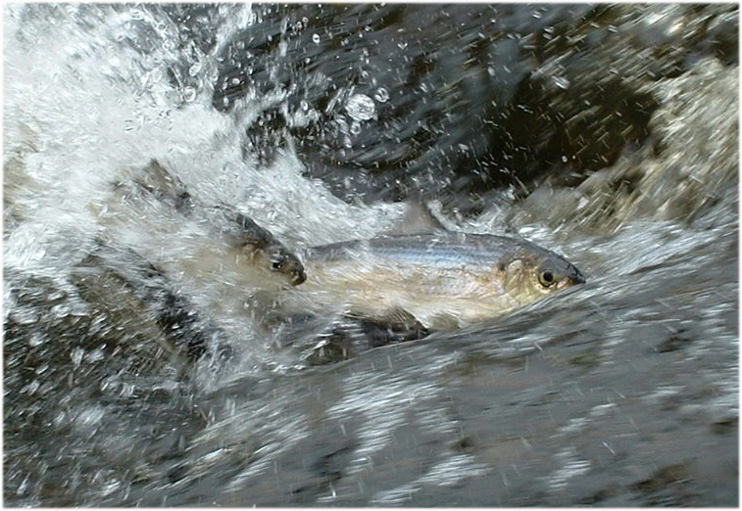
But not only residents of Tarnów have problems with it. Fish floating in the rivers are dying because of high temperature and low level of water. Special organizations are trying to deal with this problem, however, it isn’t so easy.

Slide 43
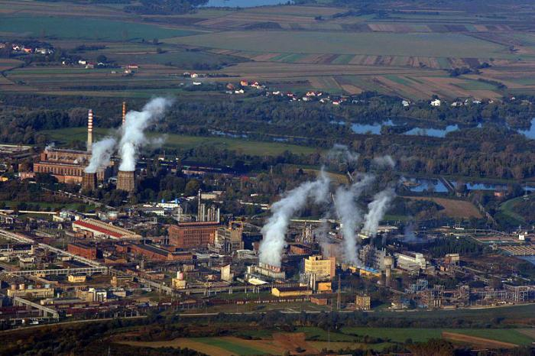
In our region, there are many different species of animals and plants threatened with extinction due to pollution. In recent years, species diversity has changed due to the development of chemical engineering in our city.
This led to a reduction in the number of valuable and typical species. But still in Tarnow, we can find many representatives of unusual and interesting species of animals and plants.

Slide 44
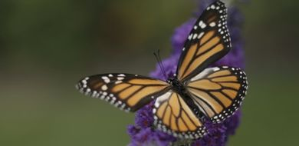
THE END ☻
Thanks for your attention !
Directed by Kinga Borsa and Adrianna Węgrzyn class 2E III Liceum Ogólnokształcące in Tarnów, Poland

