Slide 1

Comenius Project
2012-2014
Protection of Biodiversity
Germany, Italy, Poland, Spain, Turkey
Endangered spieces in Poland
ANTS

Slide 2
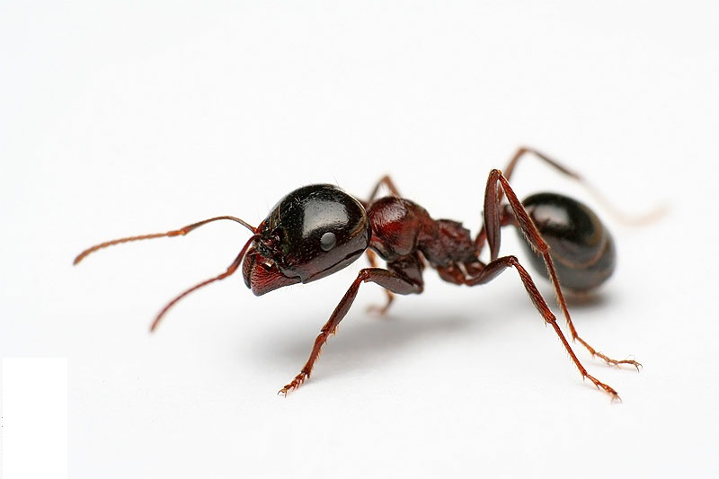
General information
about ants.

Slide 3
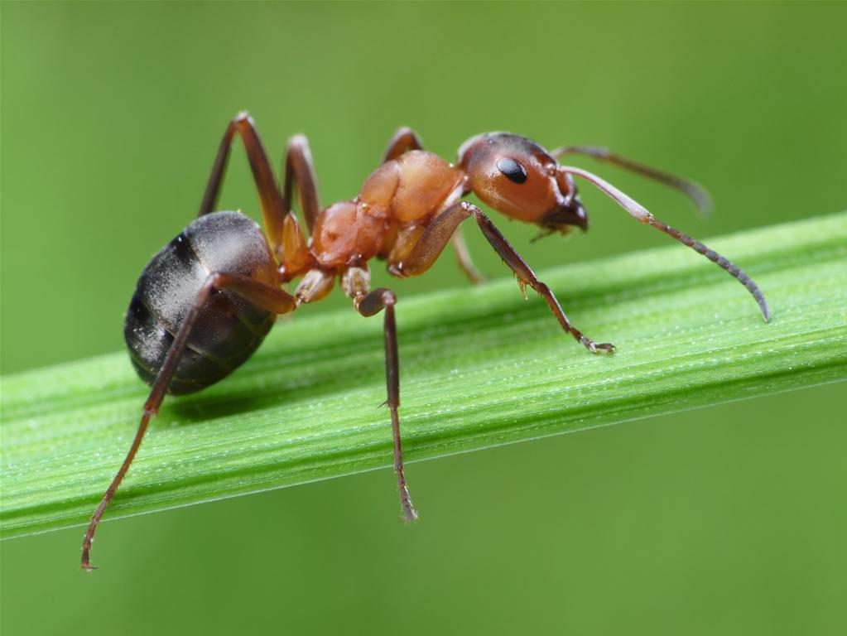
So far, there are about 12 000 species of ants known. Their main habitat are the tropics. Every year more species are discovered. There are only about 150 species of ants in Europe.
The ants are an invertebrate family, which belongs to the kingdom of animals and spike Insects. Their origin is not very clear.
Ants are social insects. This means that they build a kind of a settlement and live in a society with strict hierarchy.
An incredible agility and adaptiveness has turned ants to the most successful and numerous species on the planet.

Slide 4
Amazing
ants anatomy.

Slide 5
Ants have three main body parts: the head, the thorax (middle section), and the abdomen (rear section). The outside of an ant’s body is covered with a hard armour, which is called the exoskeleton.
Head.
The head consists of the mandibles, eyes and antennae.
The ant antennae are special organs of smell, touch, taste and hearing. A bit like having your nose, ears, eyes and fingers all combined into one.
Thorax and wings.
The part of the body connecting the head and the abdomen is called thorax. All six legs and pairs of wings connect to the thorax. Only male drones and queen ants have wings.
Legs.
Each legs has 3 segments. All 6 legs are attached to the ant’s thorax.
Abdomen and skin.
The abdoment contains the stomach, the rectum and most of the spiracles – special breathing vents. The exoskeleton has a waxy, waterproof covering called the cuticle.

Slide 6
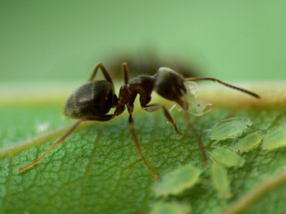
abdomen and skin
thorax and wings
head
legs

Slide 7
Ants reproduction.

Slide 8
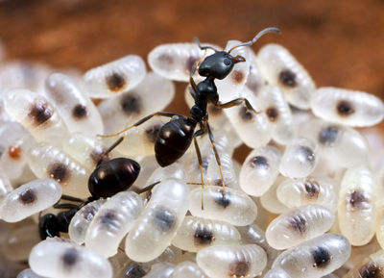
Ants are insects that go through complete metamorphosis: egg, larva, pupa, and adult. However, in most ant species, only the queen ant lays eggs. She stays in the nest. The queen-to-be mates with a male ant, then goes off to find a new nest. The male dies soon after mating.
The queen only mates once in her lifetime and may mate with several males -- the male sperm is stored live in her system for years in a special organ.
The queen lays the first few eggs and cares for the larvae herself, but after they emerge as adults, they take over and she lays eggs for the rest of her life. The worker ants collect the eggs and care for the larvae and the pupae.
The average worker ant lives only 2-3 weeks, but since new ones are being produced all the time, the colony sustains itself quite well.

Slide 9
Where do ants live ?

Slide 10
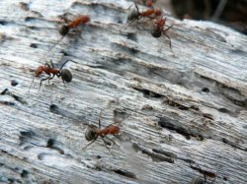
Groups of ants live in a social group called a colony. Some colonies are extremely large, with millions of individual ants. Ants spend most of their lives inside the colony.
After the queen has mated she looks for a place to build a nest. She then begins to dig and soon creates a home in which to lay her eggs. The nests of some species of ants are made up of chambers and galleries. Some ant hills can be around 2.5 m high! Ants often excavate their nests under stones or logs or underground. Some species of ants construct nests in vegetable matter, mounds of earth or in decaying trees. As soon as they are out of the pupae stage, the young worker ants start to do the work of the new nest. They dig more tunnels, find food and care for the new larvae. The queen continues to lay eggs and the size of the nest grows rapidly.

Slide 11
Food Fit for an ant.

Slide 12
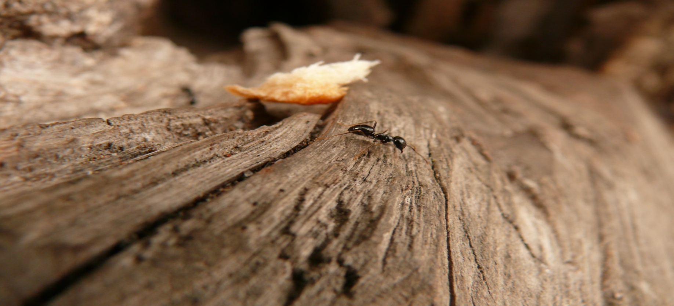
Ants eat different things, depending on the stage of their life and their role in the colony. Small larvae, for example, are fed with a mushy liquid food by older worker ants. Full-grown workers may feed directly on the food they find outside the colony. They also bring food back to the colony. Smaller ants chop up the food and process it into a liquid for others to eat.
Some workers do not eat after they become adults. Their mandibles are only designed for other duties, not for eating. The queen gets the royal treatment. Workers feed her a special liquid from their mouths.

Slide 13
Cases of ants.

Slide 14
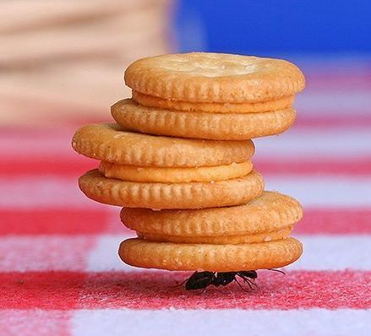
There are generally four cases. They are formed like this and have the folllowing duties:
WORKER: This the most numerous and functional caste in the ant's family. Workers hatch from fertilized eggs, which have received normal food, whose larvae have grown near the queen. By some species this depends on the size of the eggs, as well as on the time of the year, they were hatched through. Depending on their age and size, workers have different jobs. Young ants' jobs are deep inside the nest. As they get older the place they work gets closer to the surface. The oldest ants work outside the nest. The point of this is that a young unexperienced ant could not survive in the dangerous world outside the anthill. Furthermore, an old ant, whose life is coming to its end is not as valuable as this of a young ant. This is how ants keep their number.

Slide 15
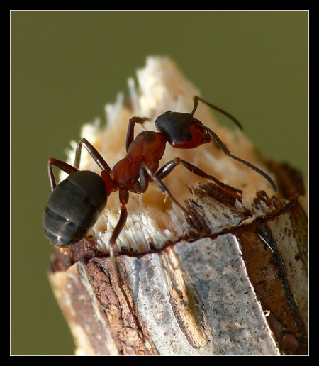
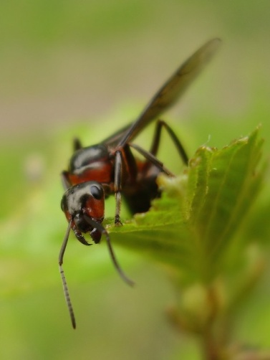
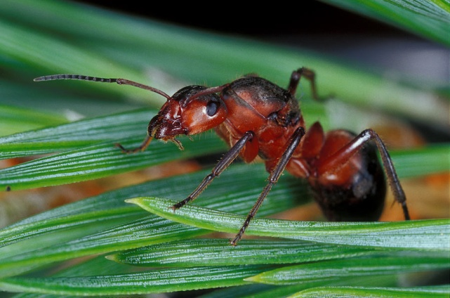
QUEEN :The queen is the main figure in the ants' society. She can get up to 25 years old. Her life begins as a princess. She gets born out of fertilized eggs, brought up far from the queen, whose larvae were fed on special food, produced by a special gland of the workers. In some species this depends on the time of the year and the size of the egg.
DRONE :The drones are the male ants in the colony. They are usually even smaller than the workers. Their head and mandibles (ant's jaws) are small. One can see their genitals with the naked eye. Their complex eyes are larger than these of workers or females.
SOLIDER : Soldiers are workers with huge heads and mandibles. Their function is to defend the nest, as well as take part in attacks against other colonies or different prey animals. By some species which feed on seeds, soldiers are responsible for breaking the hard cover of a seed, so that other ants can eat it.

Slide 16
Ants in the environment.

Slide 17
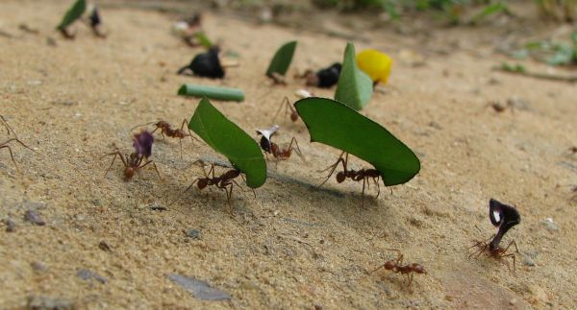
Where Ants Fit In
Ants are small, but they play a critical role in the health of the environment in which they live. For example, they pollinate flowers while searching for sweet nectar and pollen. A few species of ants even “milk” a sweet liquid from other insects.
They Really Clean Up
Ants have been called the janitors of the world because they do a lot of clean-up jobs! With their strong jaw-like mandibles, ants can cut up just about anything and haul it back to their colony. They can make a meal out of dead leaves or dead insects. They even cart away small birds and mammals after they die. The remains of a dead African zebra - after lions have finished feeding on it - will feed thousands of ants.

Slide 18
Ants and people.

Slide 19
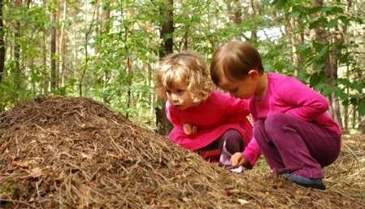
Ants and people have an unusual relationship. Interestingly, we have many traits in common with ants. We both work hard, live in colonies or communities for the good of all, and play a strong role in shaping our environment. In some places, people eat ants. Ants serve as an important source of protein for them.
Ants Keep the Soil Healthy
Some people find ants bothersome, because they sometimes raid gardens or invade people’s homes. But ants are critical to the health of the environment. They recycle huge amounts of nutrients each day by cutting up leaves and twigs and moving soil. In fact, ants move more soil than worms!

Slide 20
Interesting facts
about ants.

Slide 21
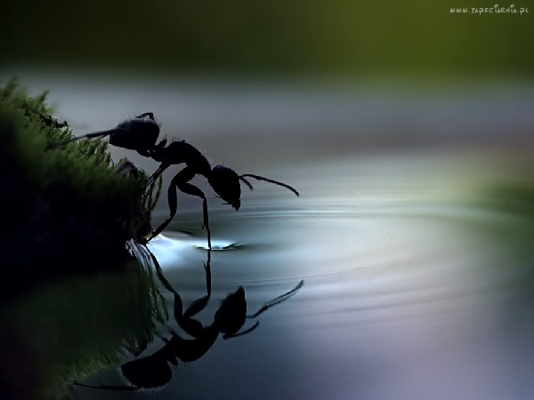
Ants don’t have ears. Ants "hear" by feeling vibrations in the ground through their feet.
Some queen ants can live for many years and have millions of babies!
An ant can lift 20 times its own body weight.
When ants fight, it is usually to the death!
When foraging, ants leave a pheromone trail so that they know where they’ve been.
Ants don’t have lungs. Oxygen enters through tiny holes all over the body and carbon dioxide leaves through the same holes.
When the queen of the colony dies, the colony can only survive a few months. Queens are rarely replaced and the workers are not able to reproduce.
The total biomass of all the ants on Earth is roughly equal to the total biomass of all the people on Earth.
Ants started farming long before humans.
Ants lived alongside the dinosaurs.

Slide 22
